Slide 1

Finite Element Analysis
Indian Institute of Technology Roorkee
Volumetric Locking And Its Alleviation In Finite Element Analysis
Under the guidance of
Prof. Dr. M.M.Jogelekar
Ankur Gaur (19538004)
Arun Kumar (19538005)
Prateek Pawar (19538009)
25-Nov-2019 1/12

Slide 2
Finite Element Analysis
Indian Institute of Technology Roorkee
Introduction
Objective : Alleviation of volumetric locking which occurs due to ill-conditioned system of finite element equations in a 2D plate(plane stress condition) using reduced point integration scheme.
What is Locking?
Finite elements are said to “lock” if they exhibit an unphysically stiff response to deformation.
Locking can occur for many different reasons as
The governing equations which are trying to solve are poorly conditioned, which leads to an ill-conditioned system of finite element equations.
The element interpolation functions are unable to approximate accurately the strain distribution in the solid, so the solution converges very slowly as the mesh size is reduced.
In certain element formulations (especially beam, plate, and shell elements), displacements and their derivatives are interpolated separately. Locking can occur in these elements if the interpolation functions for displacements and their derivatives are not consistent.
25-Nov-2019 2/12

Slide 3
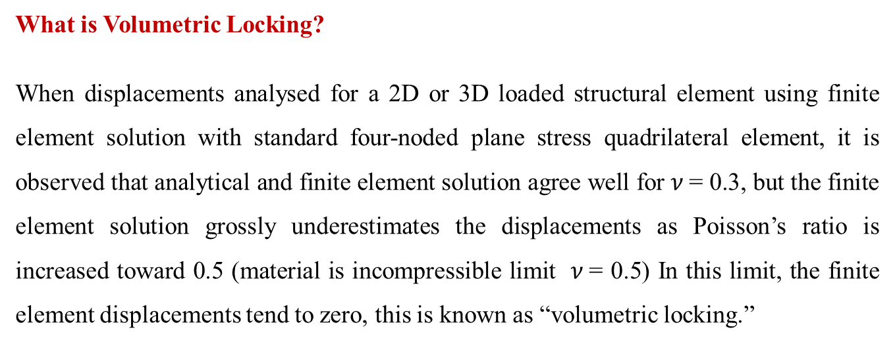
Finite Element Analysis
Indian Institute of Technology Roorkee
Introduction
What is Volumetric Locking?
When displacements analysed for a 2D or 3D loaded structural element using finite element solution with standard four-noded plane stress quadrilateral element, it is observed that analytical and finite element solution agree well for $ν$= 0.3, but the finite element solution grossly underestimates the displacements as Poisson’s ratio is increased toward 0.5 (material is incompressible limit $ν$= 0.5) In this limit, the finite element displacements tend to zero, this is known as “volumetric locking.”
25-Nov-2019 3/12

Slide 4
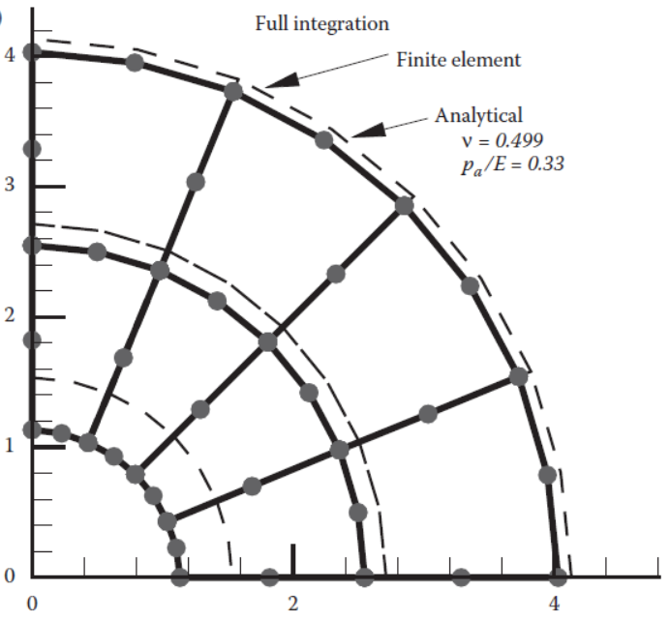
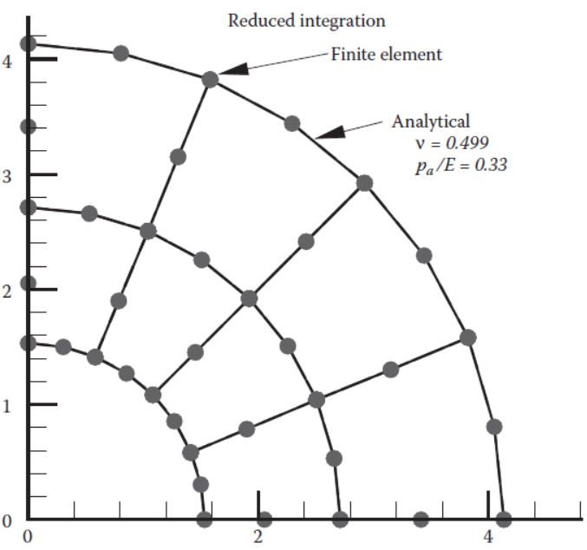
Finite Element Analysis
Indian Institute of Technology Roorkee
Introduction
25-Nov-2019 4/12

Slide 5
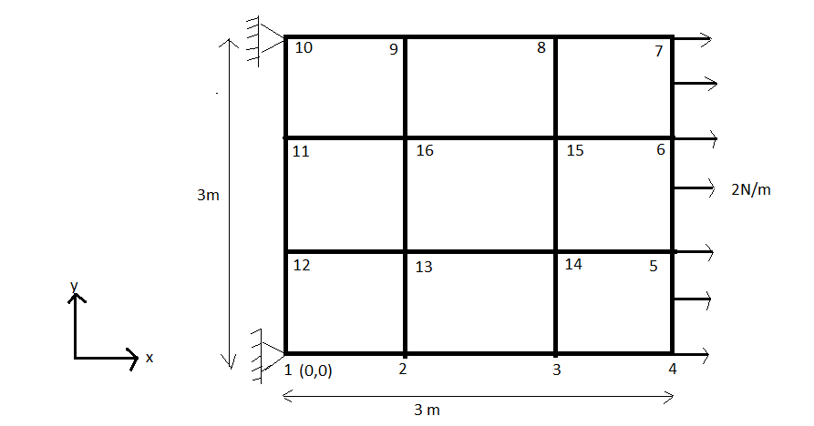
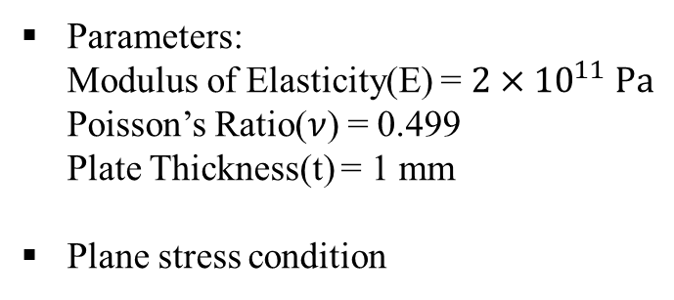
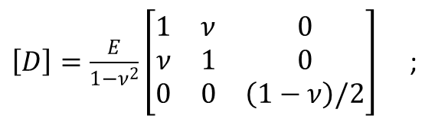

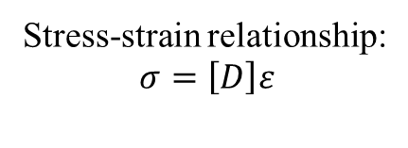
Finite Element Analysis
Indian Institute of Technology Roorkee
Development Framework
Problem Description : 2D Plate subjected to uniform loading
Parameters:
Modulus of Elasticity(E) = ${2×10}^{11} Pa$
Poisson’s Ratio($ν$) = 0.499
Plate Thickness(t) = 1 mm
Plane stress condition
Stress-strain relationship:
$$σ=\left[D\right]ε$$
$\left[D\right]=\frac{E}{1−ν^{2}}\left[\begin{matrix}1 & ν & 0 \\ ν & 1 & 0 \\ 0 & 0 & \left(1−ν\right)/2\end{matrix}\right]$ ;
$∀$,
25-Nov-2019 5/12

Slide 6
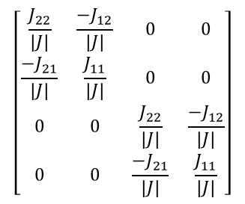

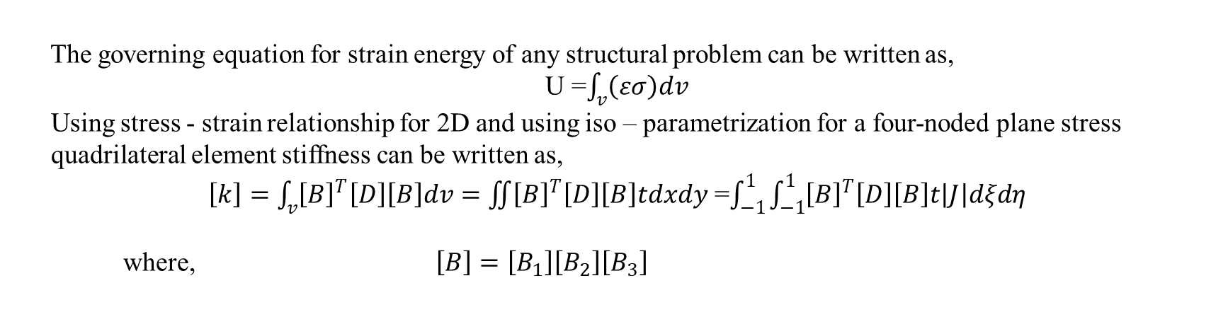



Finite Element Analysis
Indian Institute of Technology Roorkee
Development Framework : Full Integration Finite Element Method
The governing equation for strain energy of any structural problem can be written as,
U =$\int_{v}{\left(εσ\right)dv}$
Using stress - strain relationship for 2D and using iso – parametrization for a four-noded plane stress
quadrilateral element stiffness can be written as,
$\left[k\right]=\int_{v}{{\left[B\right]}^{T}\left[D\right]\left[B\right]dv=\iint{{\left[B\right]}^{T}\left[D\right]\left[B\right]tdxdy}}$ =$\int_{−1}^{1}{\int_{−1}^{1}{{\left[B\right]}^{T}\left[D\right]\left[B\right]t\left|J\right|dξdη}}$
where, $\left[B\right]=\left[B_{1}\right]\left[B_{2}\right]\left[B_{3}\right]$
$$\left[\begin{matrix}\frac{J_{22}}{\left|J\right|} & \frac{−J_{12}}{\left|J\right|} & 0 & 0 \\ \frac{−J_{21}}{\left|J\right|} & \frac{J_{11}}{\left|J\right|} & 0 & 0 \\ 0 & 0 & \frac{J_{22}}{\left|J\right|} & \frac{−J_{12}}{\left|J\right|} \\ 0 & 0 & \frac{−J_{21}}{\left|J\right|} & \frac{J_{11}}{\left|J\right|}\end{matrix}\right]$$
$$B_{1}=$$
$$B_{2}=$$
$$B_{3}=$$
${∀, N}_{i}$ are interpolation functions
25-Nov-2019 6/12

Slide 7
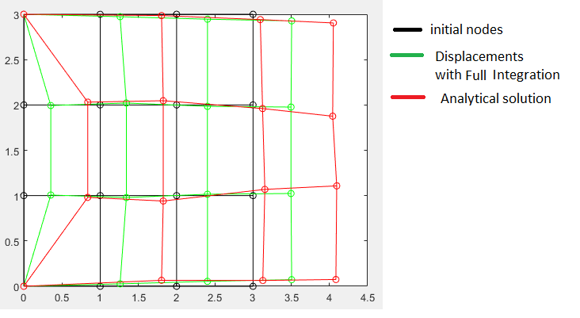
Finite Element Analysis
Indian Institute of Technology Roorkee
Development Framework : Full Integration Finite Element Method
Using Gauss Quadrature 2x2 integration scheme displacements are obtained. The values of displacement for analytical and full integration finite element method are shown as,
Figure: Displacements on nodes when full integration method is used along with analytical solution.
25-Nov-2019 7/12

Slide 8
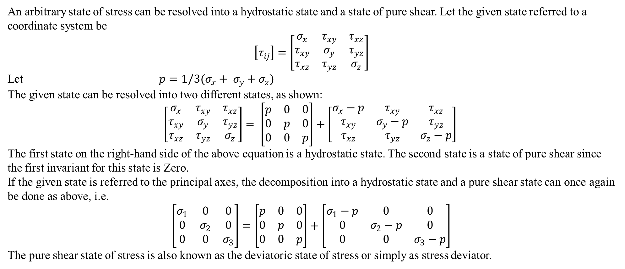
Finite Element Analysis
Indian Institute of Technology Roorkee
Development Framework : Reduced Point Integration Method
An arbitrary state of stress can be resolved into a hydrostatic state and a state of pure shear. Let the given state referred to a coordinate system be
$$\left[τ_{ij}\right]=\left[\begin{matrix}σ_{x} & τ_{xy} & τ_{xz} \\ τ_{xy} & σ_{y} & τ_{yz} \\ τ_{xz} & τ_{yz} & σ_{z}\end{matrix}\right]$$
Let $p=1/3(σ_{x}+ σ_{y}+σ_{z})$
The given state can be resolved into two different states, as shown:
$$\left[\begin{matrix}σ_{x} & τ_{xy} & τ_{xz} \\ τ_{xy} & σ_{y} & τ_{yz} \\ τ_{xz} & τ_{yz} & σ_{z}\end{matrix}\right]= \left[\begin{matrix}p & 0 & 0 \\ 0 & p & 0 \\ 0 & 0 & p\end{matrix}\right]+\left[\begin{matrix}σ_{x}−p & τ_{xy} & τ_{xz} \\ τ_{xy} & σ_{y}−p & τ_{yz} \\ τ_{xz} & τ_{yz} & σ_{z}−p\end{matrix}\right]$$
The first state on the right-hand side of the above equation is a hydrostatic state. The second state is a state of pure shear since the first invariant for this state is Zero.
If the given state is referred to the principal axes, the decomposition into a hydrostatic state and a pure shear state can once again be done as above, i.e.
$$\left[\begin{matrix}σ_{1} & 0 & 0 \\ 0 & σ_{2} & 0 \\ 0 & 0 & σ_{3}\end{matrix}\right]=\left[\begin{matrix}p & 0 & 0 \\ 0 & p & 0 \\ 0 & 0 & p\end{matrix}\right]+\left[\begin{matrix}σ_{1}−p & 0 & 0 \\ 0 & σ_{2}−p & 0 \\ 0 & 0 & σ_{3}−p\end{matrix}\right]$$
The pure shear state of stress is also known as the deviatoric state of stress or simply as stress deviator.
25-Nov-2019 8/12

Slide 9
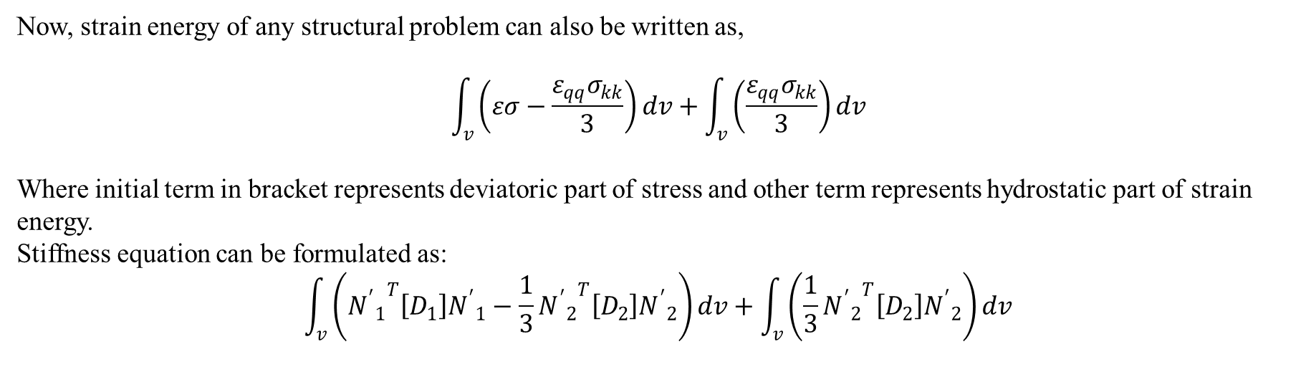

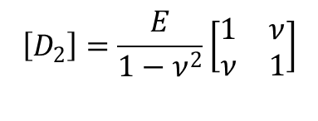
Finite Element Analysis
Indian Institute of Technology Roorkee
Development Framework : Reduced Point Integration Method
Now, strain energy of any structural problem can also be written as,
$$\int_{v}{\left(εσ−\frac{ε_{qq}σ_{kk}}{3}\right)dv}+\int_{v}{\left(\frac{ε_{qq}σ_{kk}}{3}\right)dv}$$
Where initial term in bracket represents deviatoric part of stress and other term represents hydrostatic part of strain energy.
Stiffness equation can be formulated as:
$$\int_{v}{\left({{N^{′}}_{1}}^{T}\left[D_{1}\right]{N^{′}}_{1}−\frac{1}{3}{{N^{′}}_{2}}^{T}\left[D_{2}\right]{N^{′}}_{2}\right)}dv+\int_{v}{\left(\frac{1}{3}{{N^{′}}_{2}}^{T}\left[D_{2}\right]{N^{′}}_{2}\right)}dv$$
$$\left[D_{2}\right]=\frac{E}{1−ν^{2}}\left[\begin{matrix}1 & ν \\ ν & 1\end{matrix}\right]$$
${N^{′}}_{2}$ =
25-Nov-2019 9/12

Slide 10
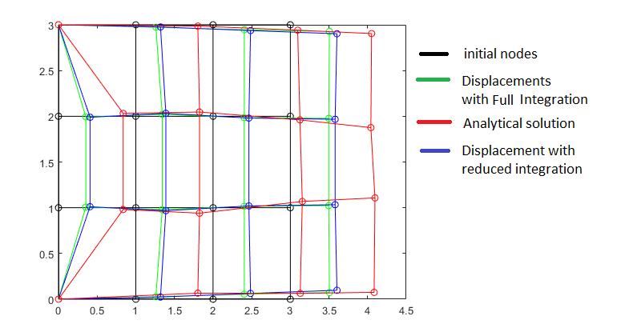
Finite Element Analysis
Indian Institute of Technology Roorkee
Development Framework : Reduced Point Integration Method
In Reduced Point Integration method, integrating deviatoric part of strain energy with 2x2 point gauss quadrature integration method and hydrostatic part of strain energy using single gauss point quadrature integration method.
The values of displacement for analytical and reduced integration finite element method are obtained as,
Figure: Displacements on nodes when full integration method is used along with analytical solution.
25-Nov-2019 10/12

Slide 11
Finite Element Analysis
Indian Institute of Technology Roorkee
Conclusion :
All the standard fully integrated finite elements will lock in the incompressible limit, and some elements show very poor performance even for Poisson’s ratios as small as 0.45.
Because most materials have Poisson’s ratios around 0.3 or less, so the standard elements can be used for most linear elasticity and small strain plasticity problems.
To model rubbers, or to solve problems involving large plastic strains, the elements must be redesigned to avoid locking.
Reduced integration is the simplest way to avoid locking because the fully integrated elements cannot make the strain field volume preserving at all the integration points.
Reduced integration usually means that the element stiffness is integrated using an integration scheme that is one order less accurate than the standard scheme.
25-Nov-2019 11/12

Slide 12
Finite Element Analysis
Indian Institute of Technology Roorkee
Refrences :
[1]. Bower, Allan F, “Applied mechanics of solids”, CRC Press (2010)., Ch. 8, pp. 530-540.
[2]. Seshu, P., “Textbook of Finite Element Analysis ”, PHI Learning Private Limited (2012)., Ch. 4, pp. 145-231.
[3]. Srinath L S, “Advanced Mechanics of solids”, Tata McGraw-Hill (2009), Ch. 1, pp. 1-63.
25-Nov-2019 12/12

